Slide 1
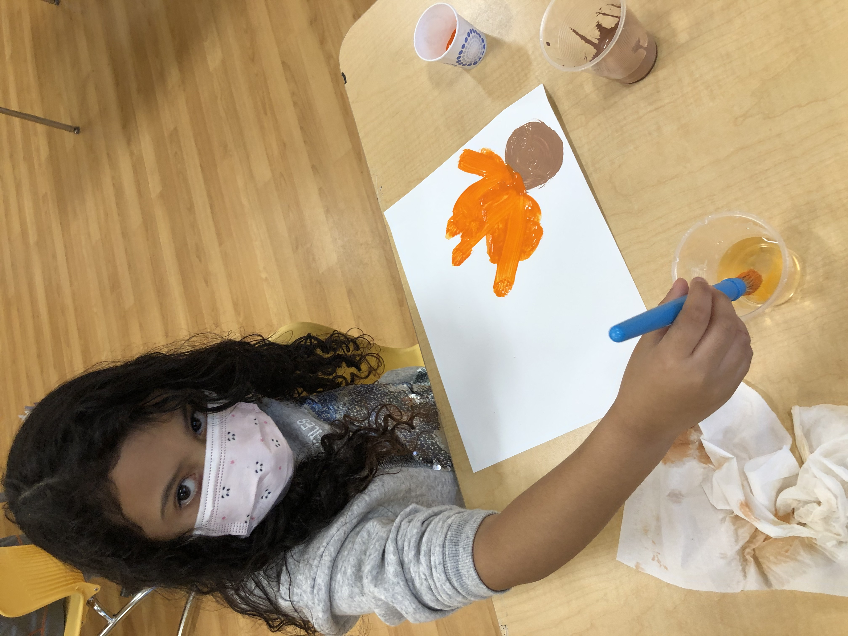
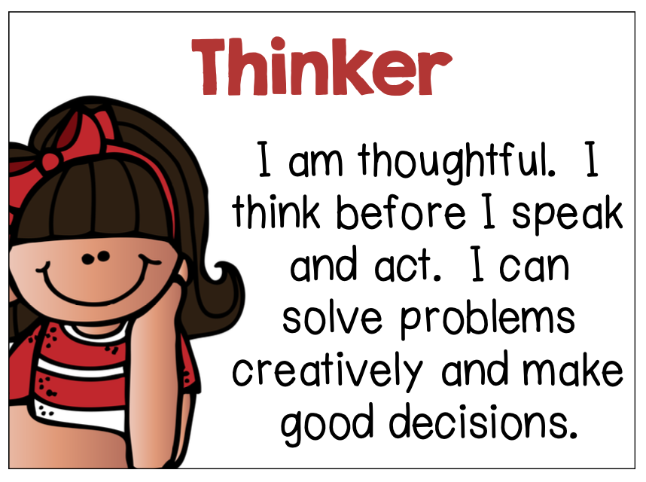
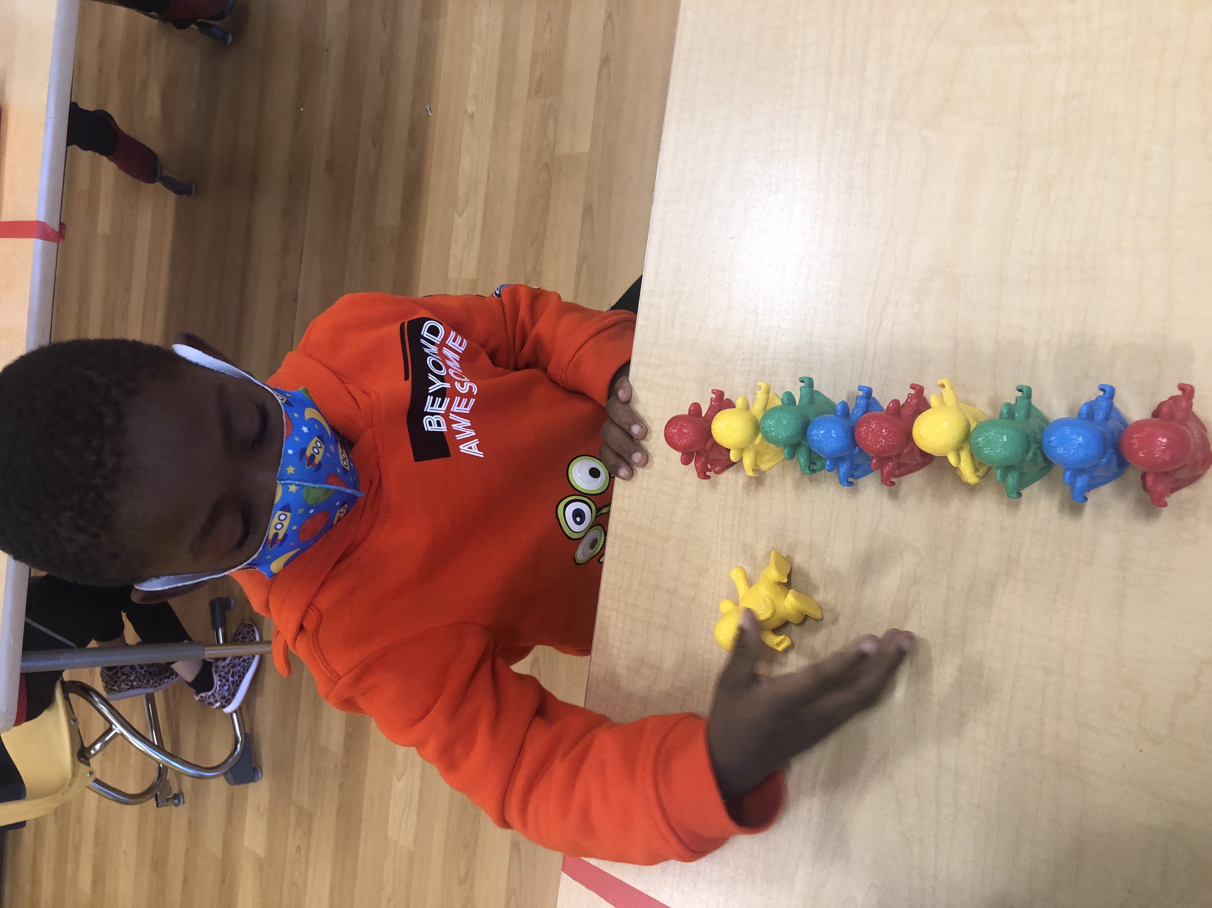
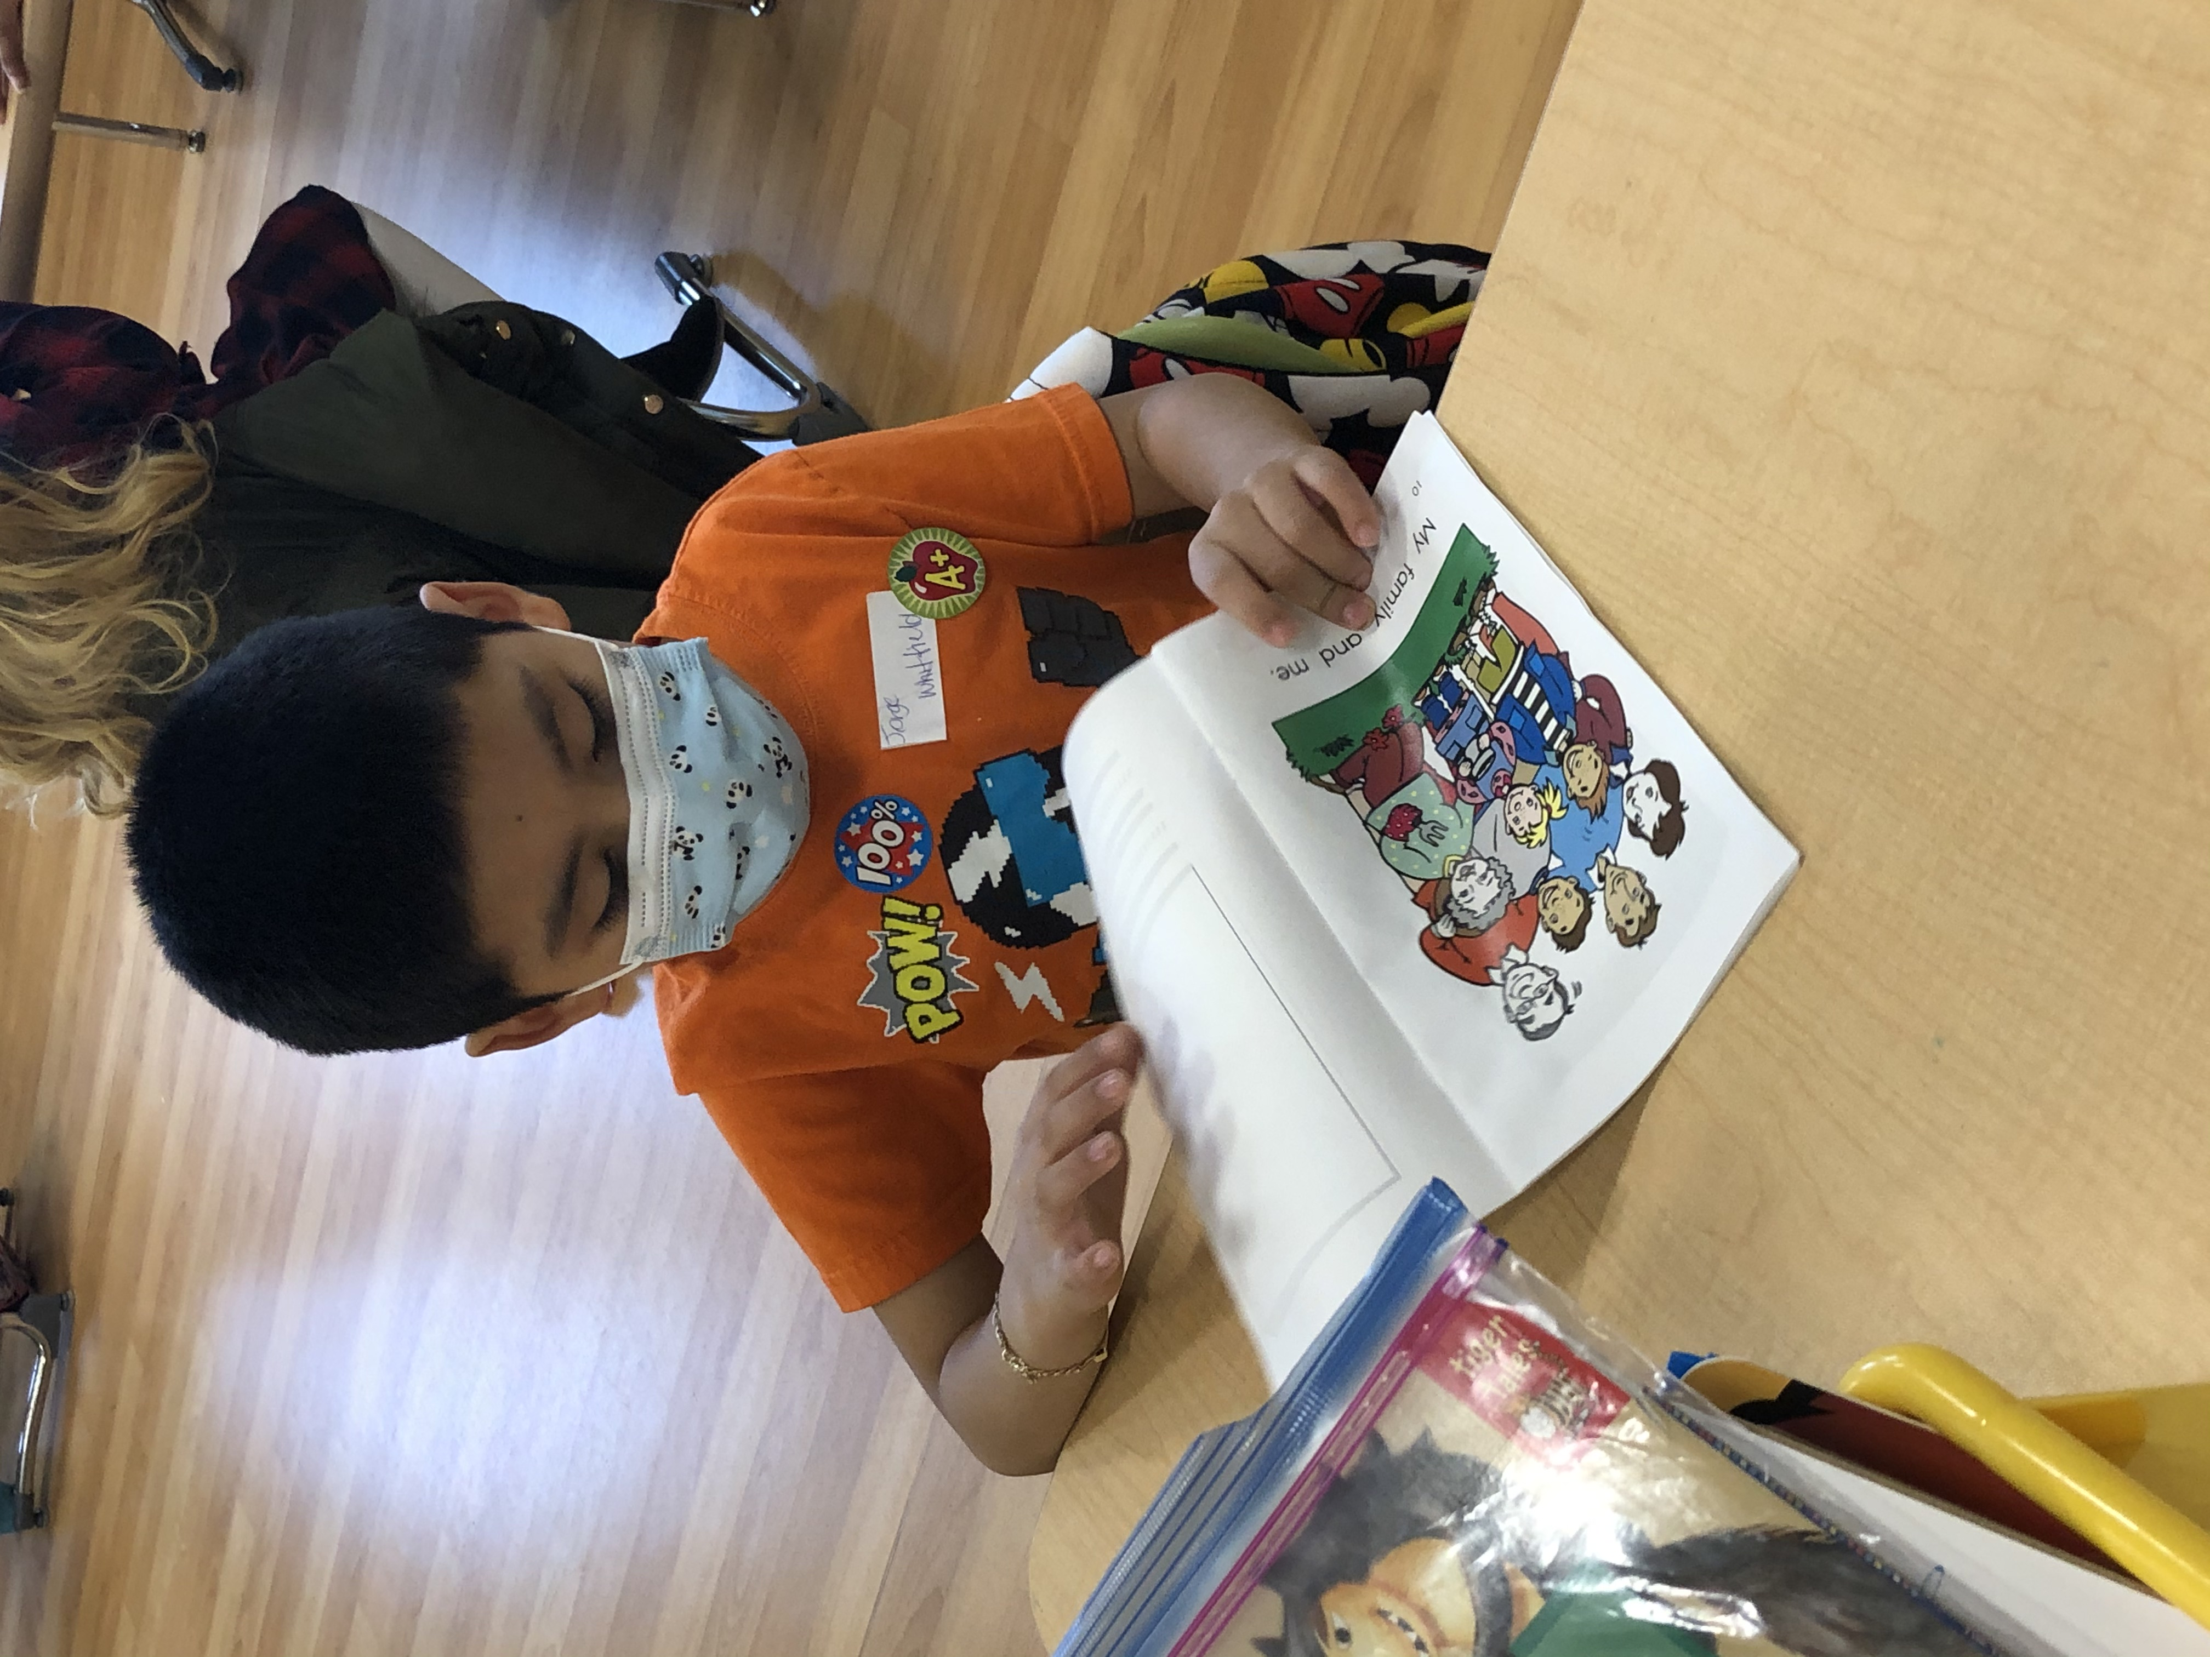
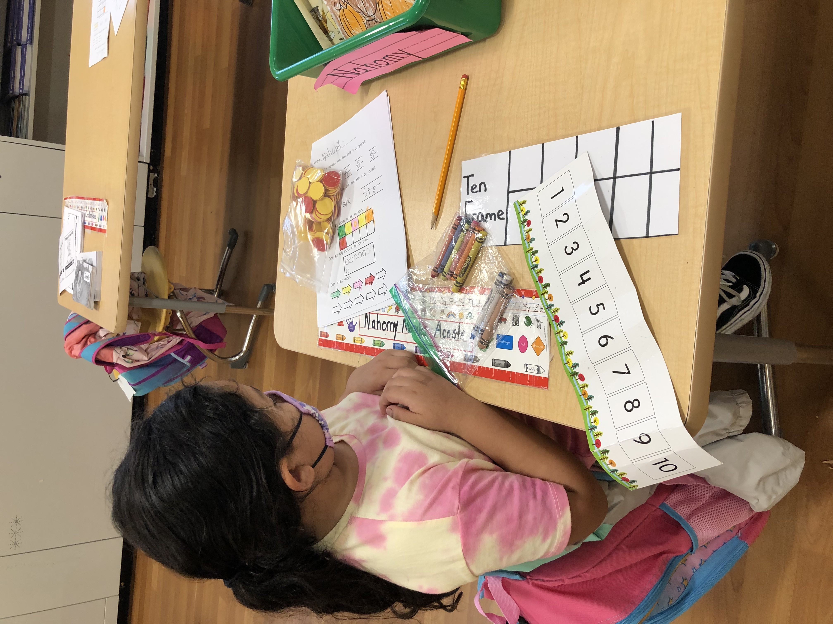
Prospect School has applied for authorization to become an International Baccalaureate World School. If you would like additional information, please contact Ms. Chung via email - rchung@hempsteadschools.org or your child’s teacher.
January’s Learner Profile Attribute is Thinker
Help your child at home by asking them questions and giving ample time to respond. Establish play time and encourage them to try new things.

Slide 2
January - Learner Profile Thinker
Students who are thinkers work to solve problems independently. They can imagine many solutions to a question or challenge. Thinkers make good decisions and can predict the outcomes of their actions. They think creatively and critically.
How can parents help to develop students who are thinkers at home?
Encourage your child to try to think of solutions to problems independently.
Pose different real-life problems and questions to your child:
“What should you do if you have a problem at school?”
“How can we keep our community clean?”
3. Ask your children questions when they are working on a problem:
“How did you come up with that answer?”
“ Why do you think that?”
“How can we do this differently?”

Slide 3
Enero: Perfil del Alumno Pensador
Estudiantes que son pensadores trabajar para resolver problemas de forma independiente. Pueden imaginar muchas soluciones a una pregunta o desafío. Los pensadores toman buenas decisiones y pueden predecir los resultados de sus acciones. Piensan de manera creativa y crítica.
¿Cómo pueden los padres ayudar a desarrollar estudiantes que sean pensadores en casa?
Anime a su hijo a que trate de pensar en soluciones a los problemas de forma independiente.
Plantee diferentes problemas y preguntas de la vida real a su hijo:
"¿Qué debes hacer si tienes un problema en la escuela?"
"¿Cómo podemos mantener limpia nuestra comunidad?"
3. Haga preguntas a sus hijos cuando estén trabajando en un problema:
"¿Cómo se te ocurrió esa respuesta?"
" ¿Por qué piensas eso?"
"¿Cómo podemos hacer esto de manera diferente?"

